Slide 1
Institute of Formal and Applied Linguistics (ÚFAL) Projects Related to LINDAT/CLARIAH-CZ
Jan Hajič

Slide 2
LINDAT/CLARIAH-CZ in 2020/1
LINDAT = CLARIN and DARIAH in Czechia
European networks for supporting research (in SSH)
CLARIN: Language resources and technology
DARIAH: Digital humanities and arts
LINDAT/CLARIAH-CZ: 2019-2022
Combines membership in EU CLARIN and DARIAH networks
11 institutions in the Czech combined network
UK, MU, Academy of Sciences, National and Moravian Libraries, NG, NFA
Center for Visual History Malach: under LINDAT (& Herzl Center)
http://lindat.cz (redirected to https://ufal.mff.cuni.cz/lindat)
Provides also large part of computing infrastructure of UFAL
New hardware due in 2021 (OP VVV VI 2)
Lots of GPUs ☺

Slide 3
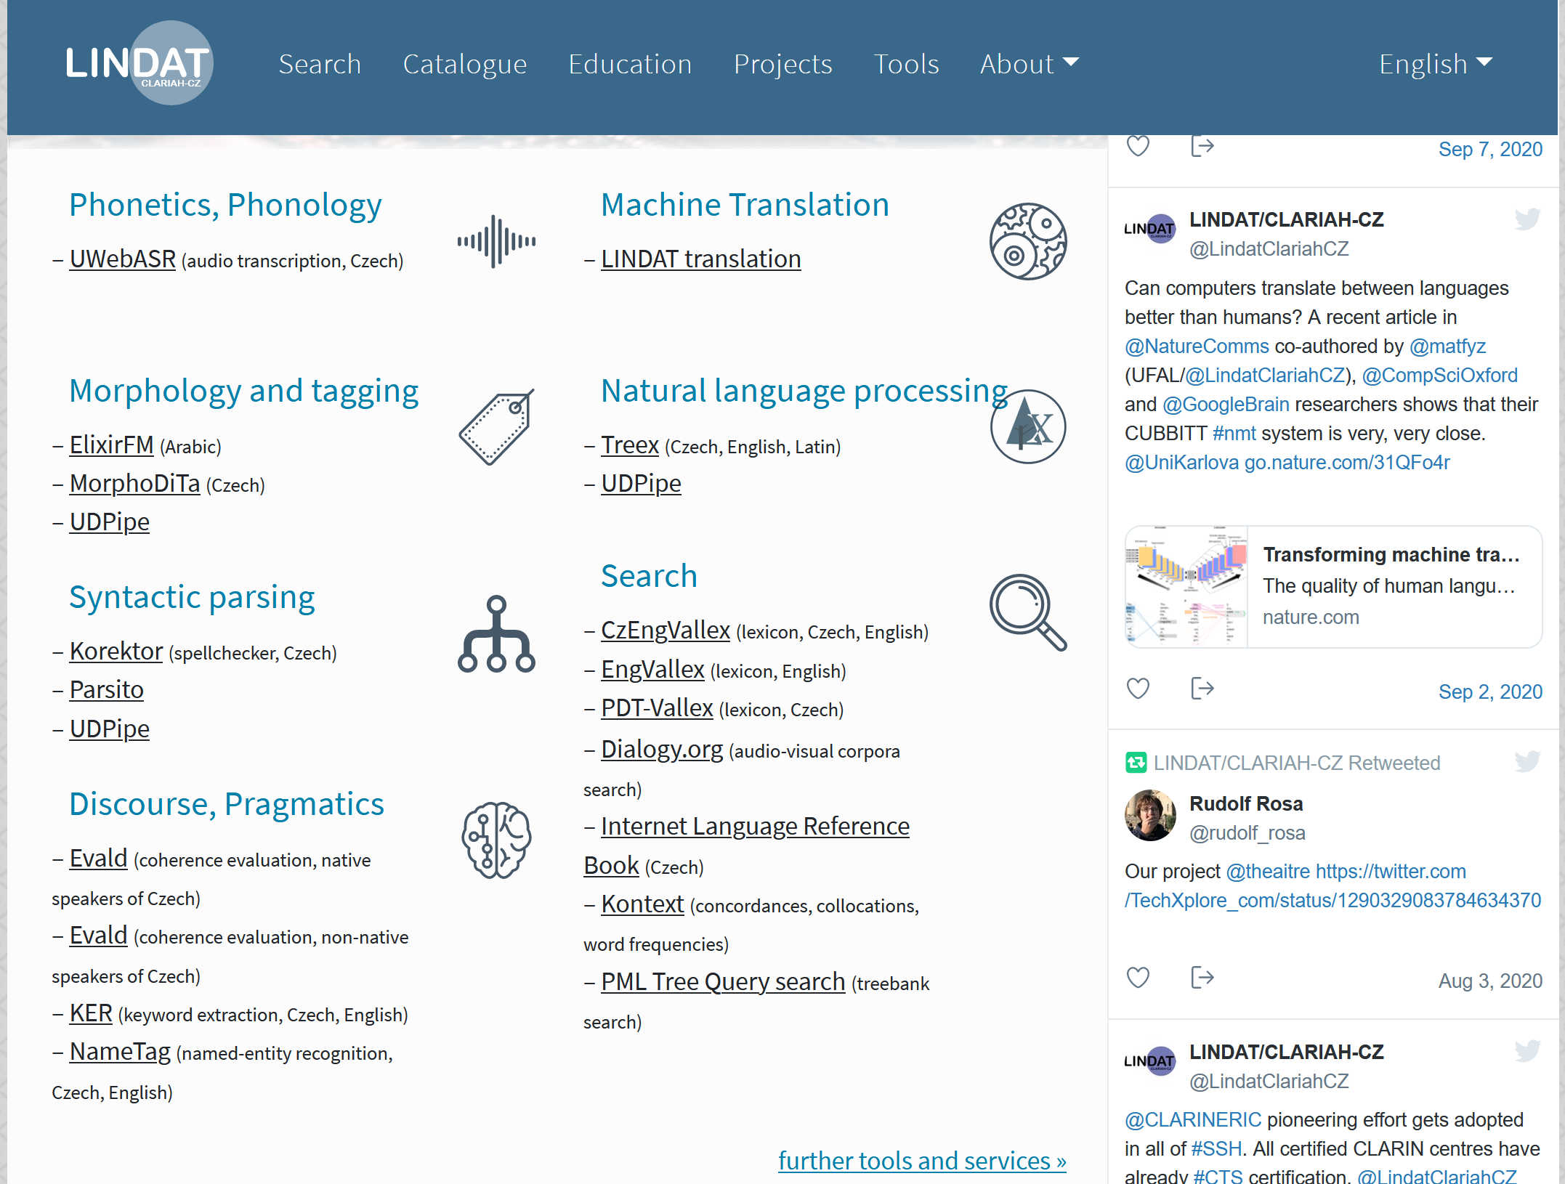
LINDAT/CLARIAH-CZ in 2020/1
New web at https://lindat.cz

Slide 4
LINDAT/CLARIAH-CZ in 2020/1
“Internal” projects – offer datasets, annotation, curation, tools, services
Repository development (CLARIN DSpace), HW and other IT support
Universal Dependencies project
General support, official editions
Tools: UDPipe (now UDPipe 2), soon to have: NER
Prague Dependency Treebank – Consolidated edition
Approx. 4MW, manual morphology
PDT, PCEDT, PDTSC, Faust; TR annotation same, a-layer: auto (PDT: manual), new morph. dictionary
SynSemClass
Multilingual (cs, en so far) event type ontology
A.k.a synonym dictionary of verbs, with valency, linked to corpora and other lexical resources
TEI:TOK
Platform for rich annotation and multimedia content
Support for other projects (GAČR, TAČR, H2020)
Running services (https://lindat.cz/en/services), maintaining HW and basic SW

Slide 5
LINDAT/CLARIAH-CZ in 2020/1
International cooperation (support or development)
ELG European Language Grid, EU H2020 Call 29a
„Marketplace“ for mainly commercial use of Language Technologies
Partners: DFKI, UK, Sheffield, ELRA, commercial partners
Pilot projects: organized by us (2M EUR), now 2nd Call (Oct 1)
Some UFAL tools provided – UDPipe, MT; harvesting repository
SSHOC, Infrastructural H2020 project
Part of CLARIN ERIC participation
UFAL/LINDAT provides basic language tools for IR, MT for Social Surveys (COVID)
Humaine-AI-Net: AI Center of Excellence, Call 48
Small participation, w/DFKI Saarbrucken: microproject (anyone…?)
ELG and SSHOC 2019-2022, Humaine-AI-Net 2020-2023
Two more submitted in 2020: ELG continuation, LANGEQ

Slide 6
Shared Tasks
Supporting Shared Tasks by data, manpower, participation
CoNLL Shared Task on Meaning Representation Parsing (MRP)
Run in 2019 (and 2020, Cz added)
Stephan Oepen & colleagues
Co-organization
Data/repo support for WMT

Slide 7
The Future
Evaluation 2021 (!!!)
We have to pass w/either of the two highest marks, otherwise LINDAT will not get funding 2023- (same for equipment)
Internal LINDAT members:
your main work for October-November/December 2020!
Others:
we might ask for help
80 page questionnaire, with partners, attachments, indicators, budget, …
Deadline: Dec. 10, 2020; interview in front of panel: May/June 2021; verdict: July 2021, full proposal for 2023-2026(9?) due in early 2022
Extended to EHRI (Holocaust research infrastructure)
Natural partner for CVHM, lead: Masarykův ústav AV ČR
Main points: SoA and new tools, equipment renewal 23-29, new resources, annotation, support to Digital Humanities, new services at partners, international cooperation (support for more projects)

